Slide 1
RappiCard
Practical Case
Here is where our journey begins

Slide 2
01
TABLE OF CONTENTS
02
03
04
$
KPIs
Stakeholder Issue
Data Structure and Governance
Business Case

Slide 3
Q1
01
We just launched a credit card to the market. As you might be aware, everyone was extremely busy planning and developing the product, but no one thought of coming up for nor monitoring the key performance indicators of the business.
What would be the key performance indicators you would come up as the most important to monitor a credit card business?
How often would you suggest such indicators must be monitored?

Slide 4
Q1
01
Indispensable:
Customer acquisition cost.
Churn rate.
Customer default.
Forfeited debt.
Net profit.
Portfolio growth rate.
Fraud incidences.
Total payment value.
Total TXNs.
Avg TPV per card.
Avg TXN per card.
Nice to have:
Industry / type of market presence.
Customer happiness → % of solved or unsolved customer issues.
Payment method usage → Physical card / digital card / contactless methods.
Card approval rate.
Credit card benefits usage

Slide 5
Q2
02
Dealing with diverse stakeholders is difficult. Where one might interpret a
concept in a way, another one might differ from such interpretation. Let’s take for example the concept ‘dormant’: some stakeholders might interpret the dormant customer as one that has not done any transactions in 6 months, where another one might say it takes only 4 months to reach this state.
Propose a problem resolution strategy with the stakeholders. How would you deal with this issue? Which facts would
you present?

Slide 6
Q2
02
Short Answer : None!
If I had to choose one or another: 6 months
Long Answer (preferred): I don´t think it is wise to brand our clients as dormants without any more background of the department we are talking about. I would suggest a deep analysis to provide an approppiate solution.
Currently I don’t have any background of how our CC is doing and how it is being used by our clients, we first need to address the following questions:
Is the CC being used by common folk or by businesses?
In what kind of industries or market is the CC being used?
Is the CC being used because it is a good product or is it only used when there are benefits?
What kind of TXNs or purchases our clients do with our CC? Are they small, big or both kind of purchases?

Slide 7
Q2
03
It is a common practice to have many systems scattered all over: where one might be hosting the app, others might be hosting models needed for daily operations. This usually benefits usability over scalability. Nevertheless, data centralization is crucial for data exploitation.
All systems share a unique identifier for all of our customers. This is the key that allows data to be joined on other databases.
What should we do to centralize the data in order to display it in charts for KPI monitoring?
What would you propose the data governance strategy should be?

Slide 8
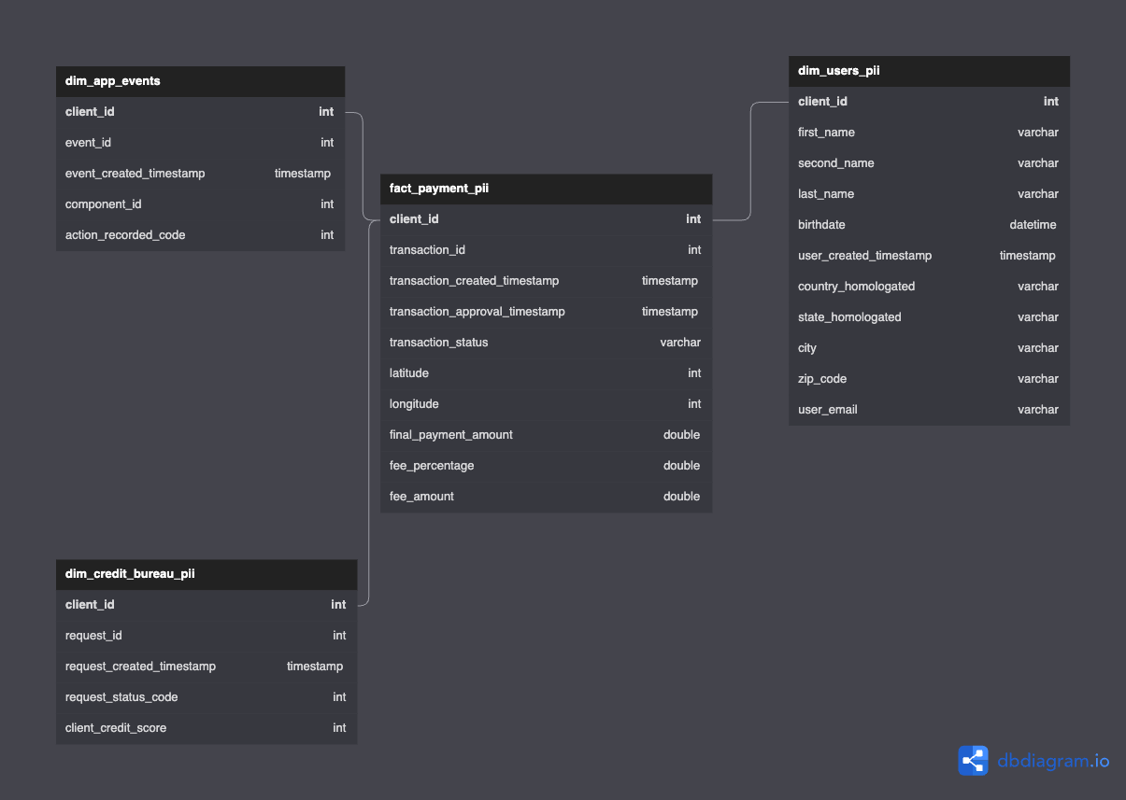
Q3

Slide 9
Q3
03
Data Governance proposal:
Data needed for every day tasks and special projects for the Data team should be in a specific data warehouse, ideally a cloud based DW.
There should be designated roles to grant access to the PII tables, perform modifications on tables or DW, etc.:
Analyst - Can’t perform DW modifications, can access every table except the ones with suffix _pii.
Research - Can’t perform DW modifications, can access every table in DW.
Engineering - Can perform DW modifications and access every table in DW, can grant roles to users.
Admin - All Engineering privileges, while also being able to create and delete users.
DW will be updated twice a day at 8AM and 8PM to ensure data quality and availability.
Data engineering team will be in charge of maintaining the DW, as well as the ETL pipelines that feed it.
Proper documentation of the DW should be developed and keep it updated for team members and any new hires.

Slide 10
BUSINESS CASE
01
$

Slide 11
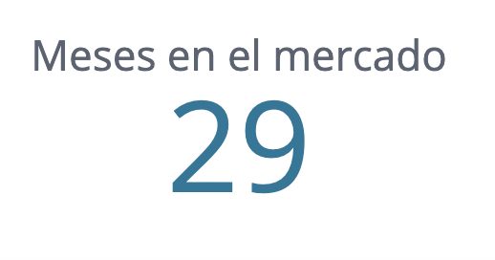
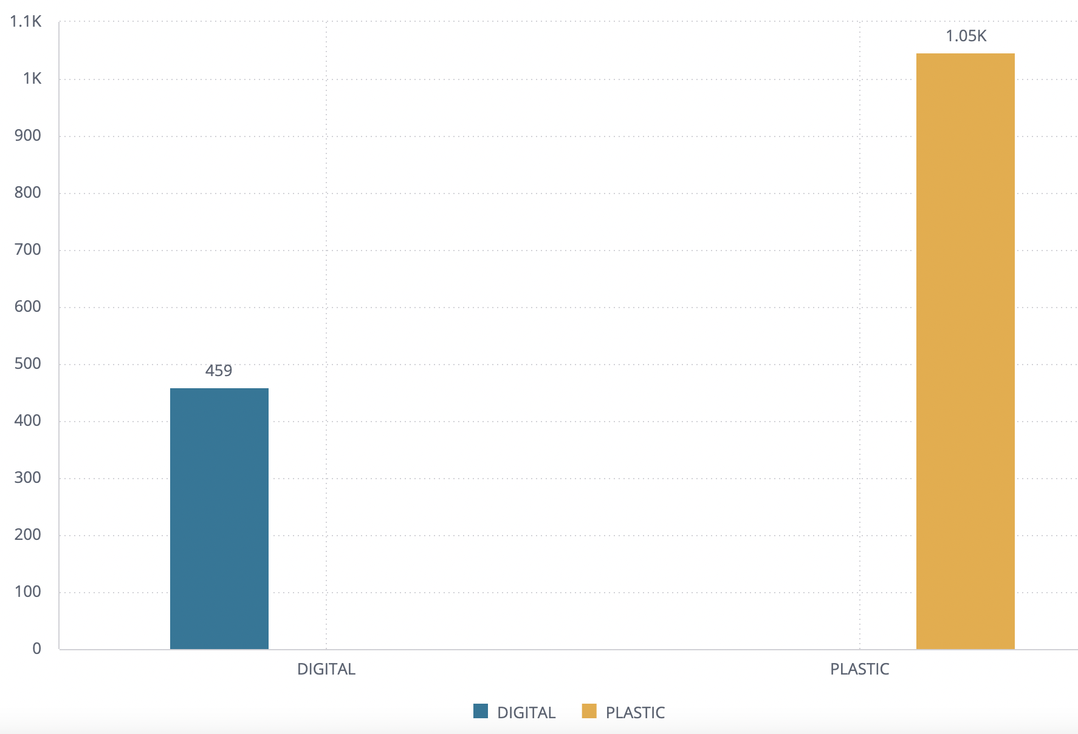
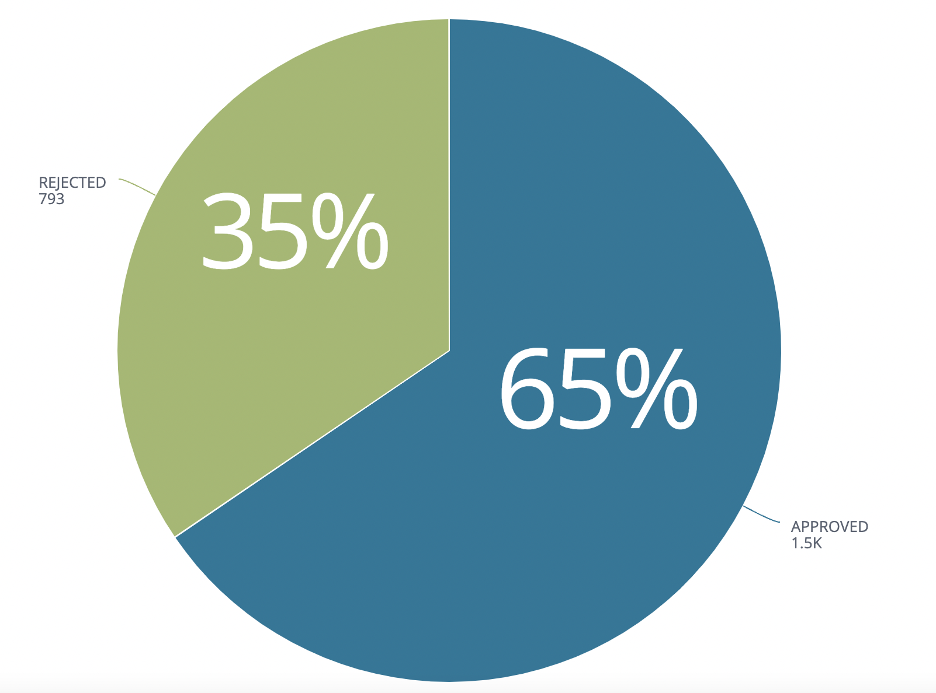
OUR PORTFOLIO

Slide 12
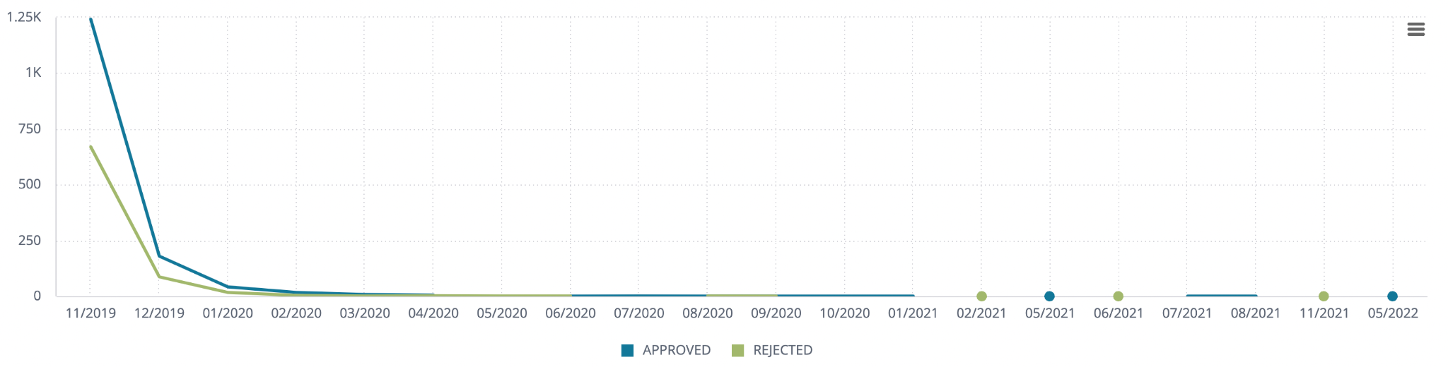
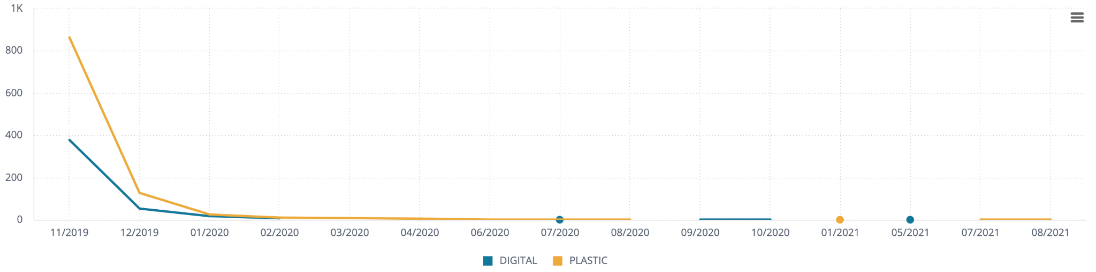
Product History

Slide 13
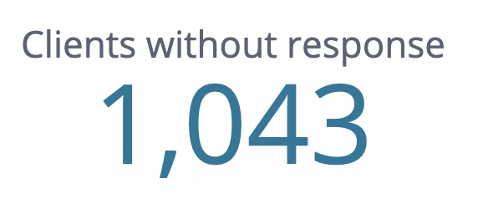
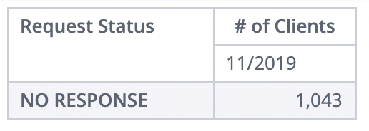
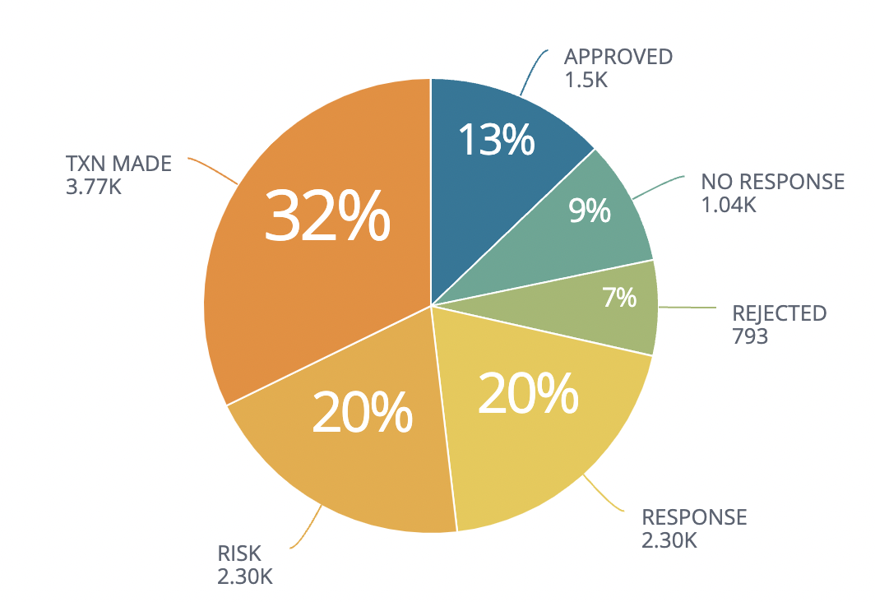
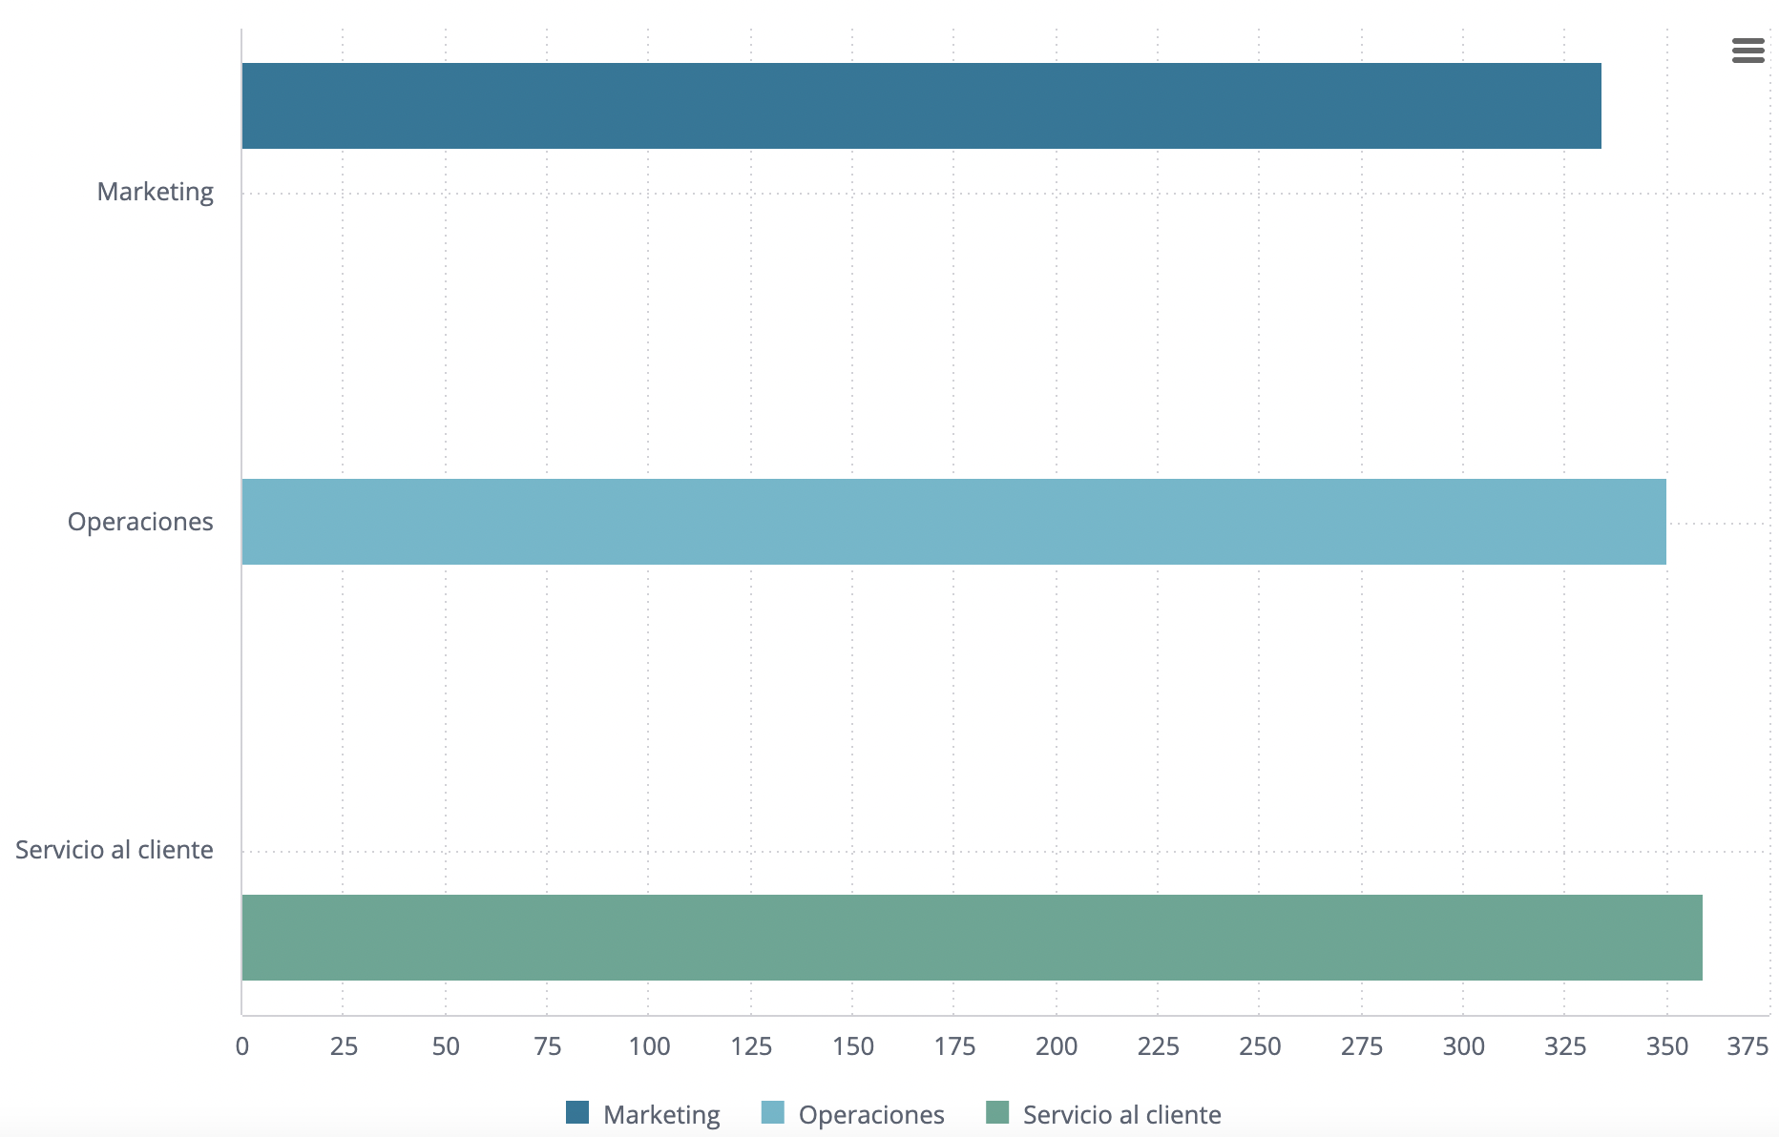
Client Leakage

Slide 14
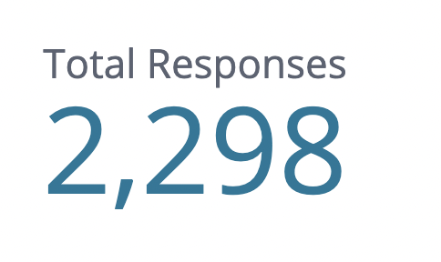
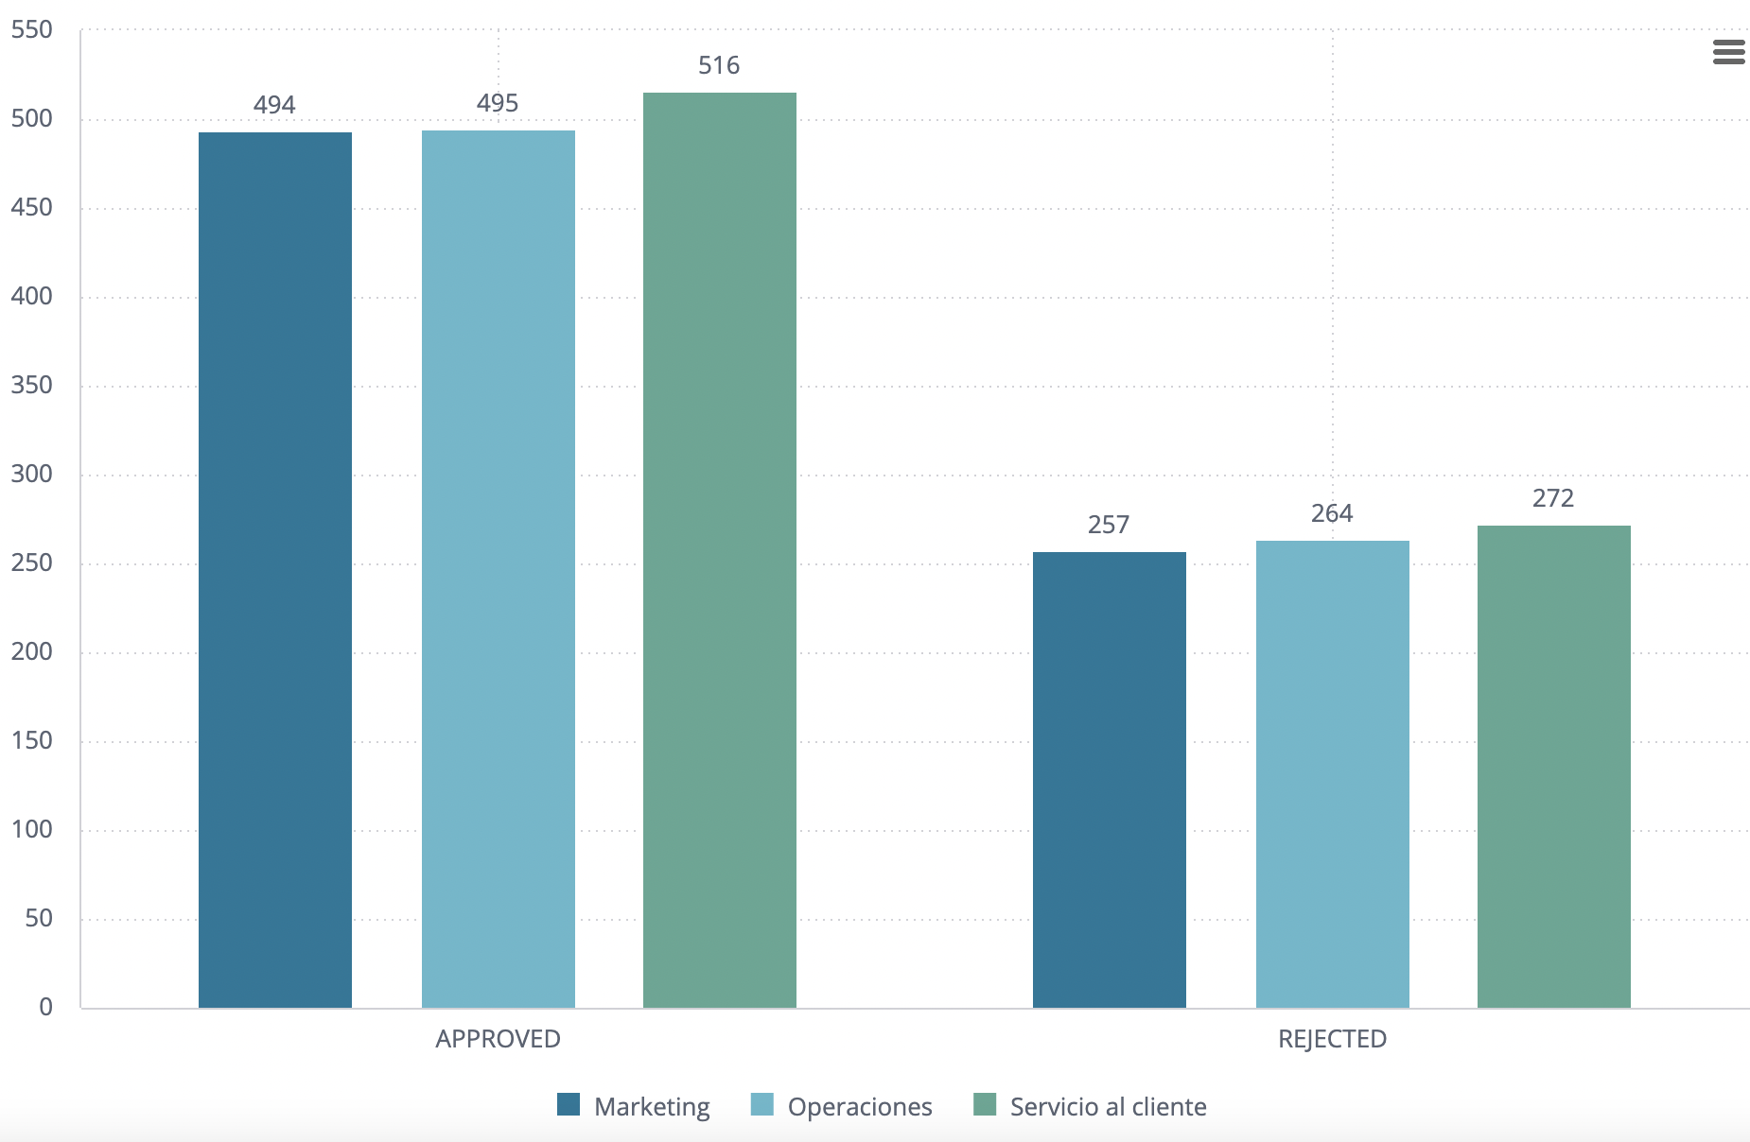
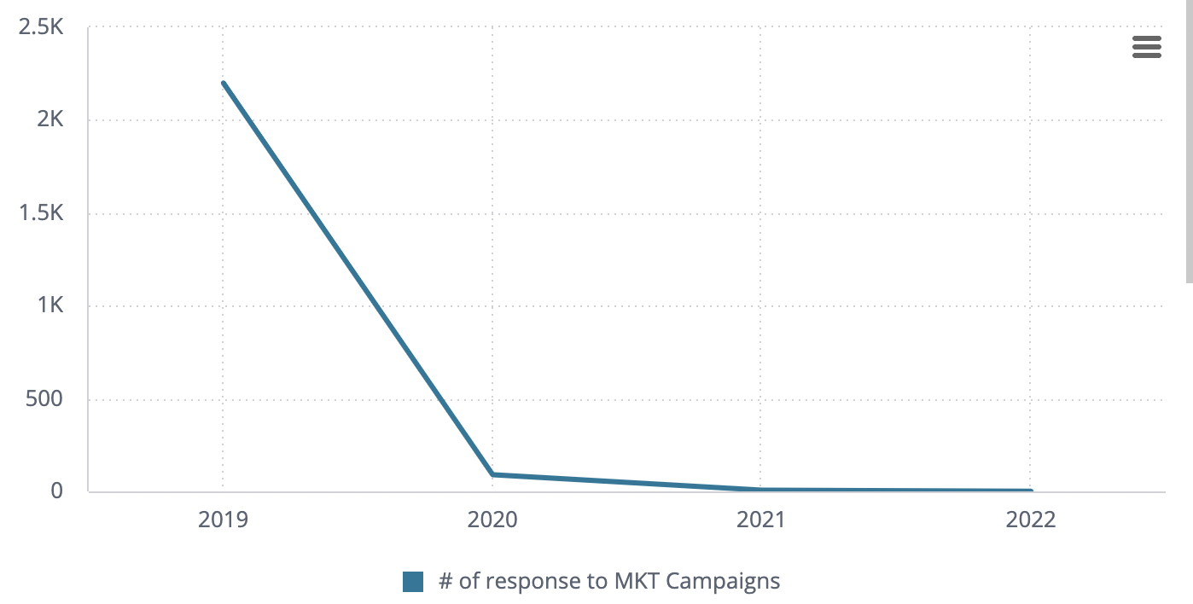
MKT RESPONSE

Slide 15
Next Steps…
Further analysis is needed:
Is the credit card still available to clients?, and if it is not available anymore, the clients who own it, are they still able to use it?
If they are still able to use the credit card, why are they not using it?
Competition / interest fees / lack of benefits / etc.
There is a strong correlation between the clients we attract and keep and marketing campaigns, if this is our top attraction channel, why the mkt campaings from 2020 and onwards haven´t been nearly as successful?
Needs further revision to analyze 2019/11 marketing campaign and understand the reasons of its success.
Are our mkt campaigns using wrong communication channels?
Nearly 10% of our records are clients that we didn´t receive any response from them, but we don´t have data about which step of the selling process we lost the clients
Suggestion: We must have a selling process / protocol that our sales reps use when talking to clients, we should record at which step we lose every single client so we can tune our process and improve our sales reps techniques

